Slide 1
Retinitis Pigmentosa
Owen Ferrara

Slide 2
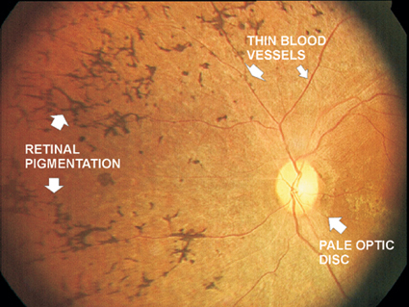
Physiological Cause
Retinitis Pigmentosa (RP) is a group of inherited diseases that causes retinal degeneration
Retina is a cell rich entity that covers the back inside wall of the eye
Responsible for taking images from the visual field
RP causes the photoreceptor cells to die
Photoreceptor cells are what detects light within the retina
These photoreceptor cells are called rods and cones
Rods: Detect dim light
Cones: Detect light and color

Slide 3
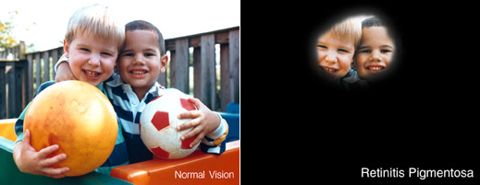
Associated Symptoms
Depends on whether the rods or the cones are affected first
Most forms cause rods to be affected first (rod-cone dystrophy)
Starts with night blindness: Patients do not adjust well to dark environments
As the disease progresses patients lose peripheral vision
Retain clear central vision
When cone is affected first it is called cone-rod dystrophy
Patients experience loss of central vision
Cannot be corrected with glasses or contact lenses
Losing more cone cells causes disturbances in color perception
Rod cells eventually get affected and patients lose peripheral vision and develop night blindness

Slide 4
Vision With RP

Slide 5
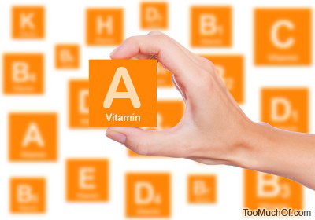
Available Treatments
No known cure
Light avoidance and low-vision aids can slow progression of RP
High doses of Vitamin A (15,000 IU/day) can slow down progression
Results not very strong and too much Vitamin A can be toxic
Gene therapy research, transplant research, and retinal prosthesis are being further researched
Gene therapy has been widely explored because RP comes from a defective gene
Gene transplant goal is to find a way to safely insert a gene into the retina
Retinal prosthesis are attempts to find a possible way to substitute a man made device to take over for the damaged photoreceptors

Slide 6
Other Treatments
Argus II Retinal Prosthesis System: A tiny video camera is built into special eyeglasses
Camera connects to a small wireless device
Video is converted to electric signals that transmit to a implant in the eye
Simulate remaining healthy retina cells, information is transmitted from the optic nerve to the brain
There it is conceived as patterns of light
Patient learns to distinguish these patterns
Electrical Stimulation Therapy: Can help preserve vision in early age patients
Done by sending small electrical signals to the retina

Slide 7
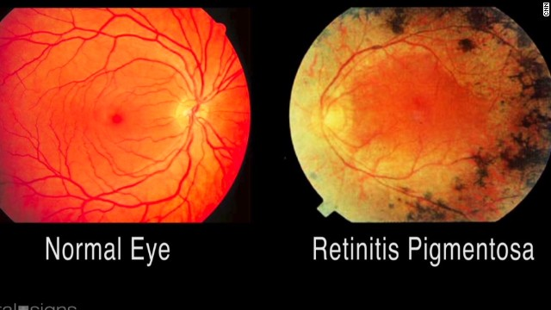
Prognosis
Typically diagnosed in adolescents and young adults
Progression of vision loss depends on the person
Majority of those with RP are legally blind by 40 years of age
Central vision field less than 20 degrees in diameter
Three types of inheritance: X linked, Autosomal dominant, and Autosomal recessive
In X linked RP families, males are more likely to have RP and are more severely affected by RP
By 50’s visual acuity of around 20/200
Autosomal dominant RP has the best prognosis patients under 30 have visual acuity of 20/30
Autosomal recessive more immediate in severity

Slide 8
Gene Affected
Mutations in more than 60 genes can cause RP
More than 20 genes responsible for the autosomal dominant form
RHO gene responsible for the majority of autosomal dominant RP patients
35 genes responsible for autosomal recessive form
USH2A gene mutations responsible for 10-15% of autosomal recessive cases
6 genes responsible for X linked RP
RPGR and RP2 genes hold the majority of X linked cases
RHO gene is on chromosome 3 and USH2A gene is on chromosome 1

Slide 9
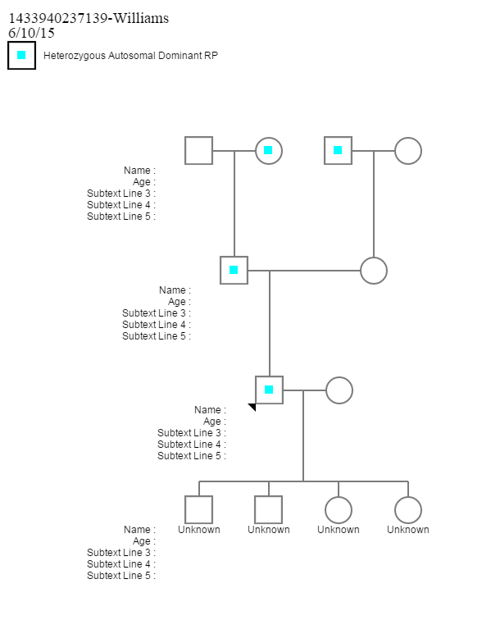
Family Pedigree
The Williams family is affected by autosomal dominant RP
Father of the unknown generation has heterozygous autosomal dominant (Rr), His spouse is (rr)

Slide 10
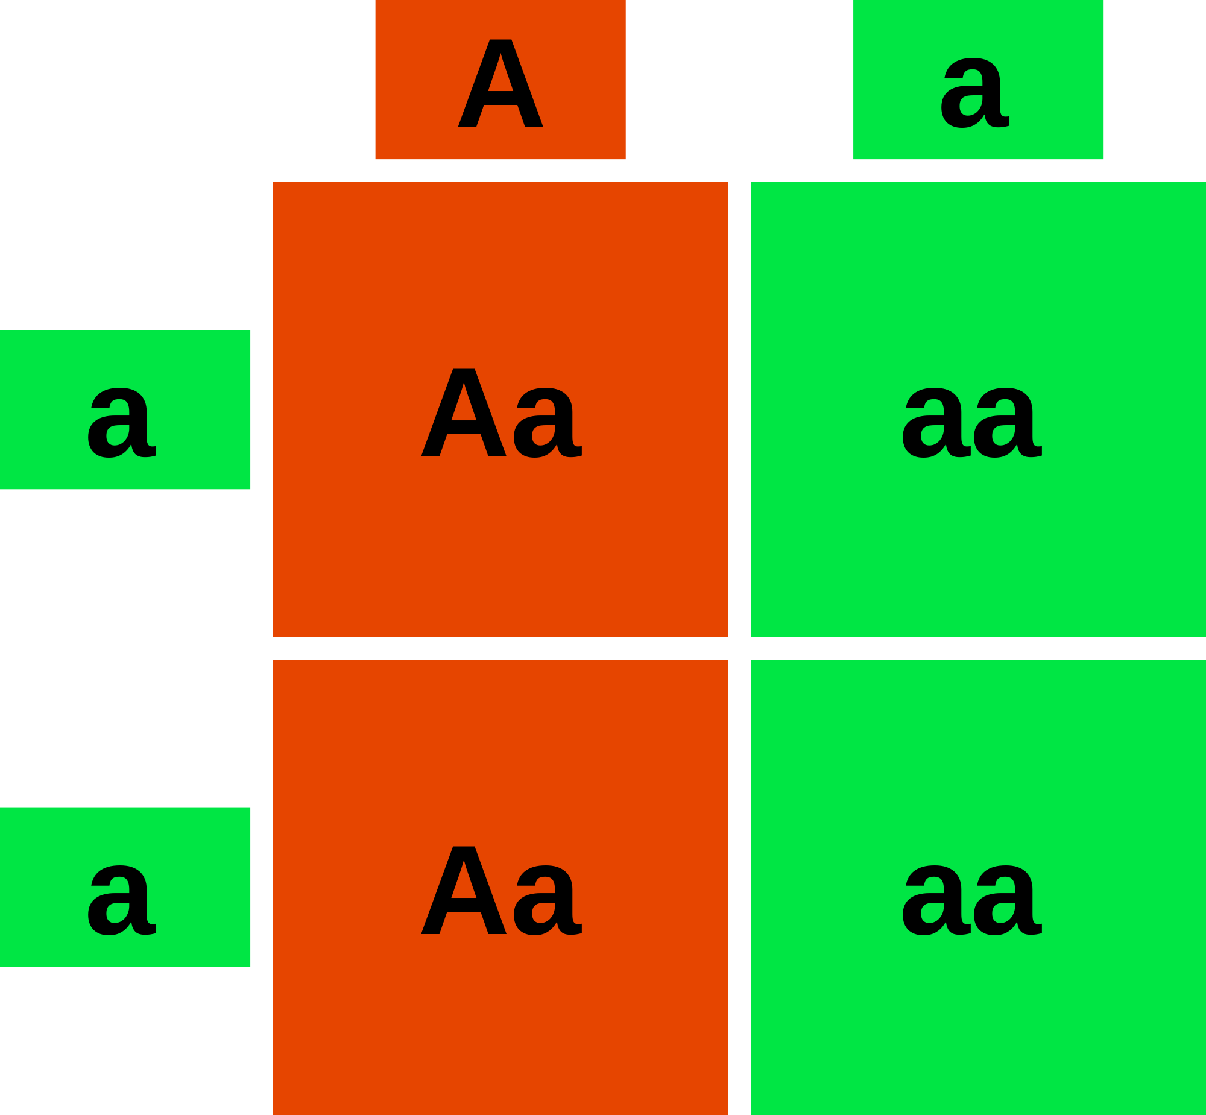
Predicted Next Generation
There is a 50% chance that the child will receive a dominant gene and a recessive gene for RP
This means that there is a 50% chance that the child will have RP
There is also a 50% chance that a child could be homozygous recessive and not have the defective gene

Slide 11
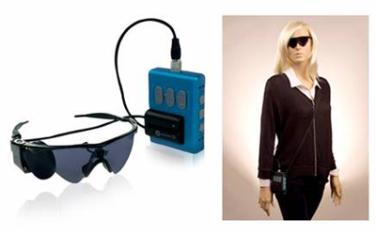
Financial Obligations/Limitations
Low vision specialist visit $200
UV protective sunglasses cost up to $150
240 Vitamin A tablet cost around $13
Low vision aids $50 or more
Cost of a Argus II Retinal Prosthesis System is around
$100,000
EST can also cost thousands per session
Limitations can arise because some patients might not be able to pay for certain treatments

Slide 12
Emotional Issues
Possible issues by hearing at a young age you might be blind or seriously visually impaired in the future
Risk of Depression
25.7% of people with RP
Emotions worsen over time
Difficult to accept that you have a terrible genetic disease

Slide 13
Ethical Considerations
Vitamin A treatment not the best
can cause issues with the liver
Most treatments FDA approved but still in testing
Possible concerns with gene therapy

Slide 14
Social Concerns
Possible chance at becoming an outcast due to visual inability
Vision can affect what kind of job you can get
School issues
Lack of independency (Need to ask for help)
Can't use public transport

Slide 15
Description of Symptoms
The patient suffers from rod-cone dystrophy
They have terrible night blindness
Their peripheral is fading
Still retain clear central vision
Headaches are a issue with this patient
The patient is not legally blind yet (20/200)

Slide 16
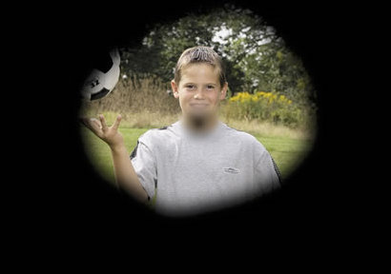
Progression of Disease
Started seeing symptoms at an early age
Best prognosis as they have autosomal dominant RP
They are under the age of 30 so their eyesight is correctable to at least 20/30
Overtime the peripheral vision will deteriorate, but so far not too much

Slide 17
Account of Living
Patient had difficulty accepting their disease
Tough knowing that eventually you will lose your sight
They take vitamin A supplements every day to hopefully slow down the disease
Not too much in order to avoid liver damage
Bought low vision glasses to help
Not a social outcast yet because disease has not progressed
Has not told their company because they do not want to be laid off

Slide 18
Concerns for the Future
Disease worsens over time
Peripheral becomes worse and worse
Eventually cost more money to treat
Could lose job and independency

Slide 19
http://eyewiki.aao.org/Retinitis_Pigmentosa#cite_note-fortyeight-50
https://www.genome.gov/13514348
http://www.blindness.org/retinitis-pigmentosa
http://www.kellogg.umich.edu/patientcare/conditions/pigmentosa.html
http://www.ncbi.nlm.nih.gov/pubmedhealth/PMHT0024256/
http://www.kellogg.umich.edu/patientcare/downloads/Understand-Retinitis-Pigmentosa.pdf
http://ghr.nlm.nih.gov/condition/retinitis-pigmentosa
http://health.costhelper.com/retinitis-pigmentosa.html
http://www.allaboutvision.com/conditions/retinapigment.htm
http://www.rehab.research.va.gov/jour/2013/508/jrrd-2012-06-0113.html

Slide 20
Bibliography
Griffiths, D., Lim, J., Epley, D., & Shah, V. (2015, May 1). Retinitis Pigmentosa. Retrieved June 12, 2015.
Haddrill, M. (2014, August 1). Retinitis Pigmentosa. Retrieved June 12, 2015.
How Much Does Retinitis Pigmentosa Treatment Cost? - CostHelper.com. (n.d.). Retrieved June 12, 2015.
Learning about Retinitis Pigmentosa. (2013, December 27). Retrieved June 12, 2015.
Lopéz, H., Pelayo, F., Justicia, M., & Morillas, C. (2013, December 11). Journal of Rehabilitation Research & Development (JRRD). Retrieved June 12, 2015.
Openshaw, A., Branham, K., & Heckenlively, J. (2008, February 1). Understanding Retinitis Pigmentosa. Retrieved June 12, 2015.
Retinitis Pigmentosa. (n.d.). Retrieved June 12, 2015.
Retinitis Pigmentosa. (n.d.). Retrieved June 10, 2015.
Retinitis Pigmentosa (RP). (n.d.). Retrieved June 7, 2015.

