Slide 1
VITILIGO
By Katie Gleason

Slide 2
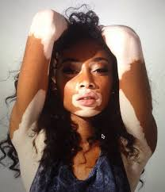
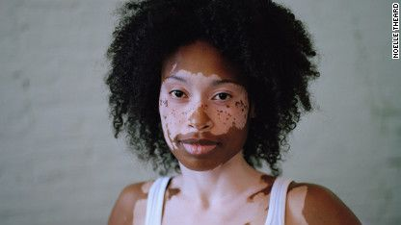
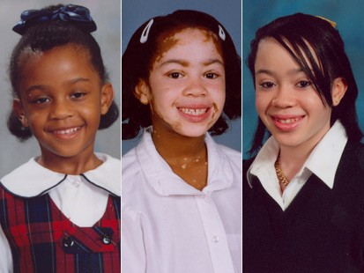
What Is It?
loss of pigment
patches of discoloration
equally affects all of the population
Tracked through families
Causes
  destruction of melanocytes
  exact reason unknown
  one possibility is autoimmune conditions

Slide 3
50,000,000
People affected, 1% of the population

Slide 4
Kinds of Vitiligo (Localized)
Localized
  Focal: one or more pigment loss in confined areas
  Segmental: one or more spots of pigment loss on one side of the body
  Mucosal: membranes are unaffected
Generalized
  Acrofacial: away from center of the body face, hands, feet
  Vulgaris: scattered patches
  Mixed: different types that are noted together
  Universal: complete or nearly complet pigment loss

Slide 5
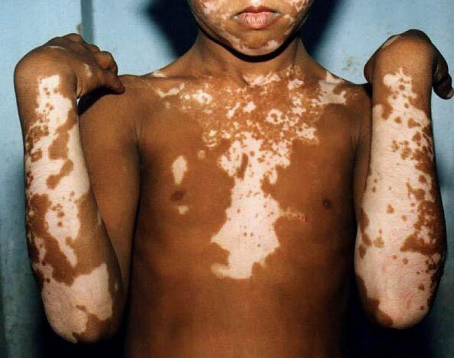
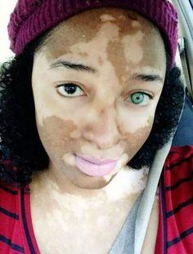
Symptoms
Rapid pigment loss
  in body folds
  areas exposed to the sun
  previous sites of energy
  areas around body openings
  areas around moles
usually slows to a stop for periods of time but can rturn and start this cycle over again

Slide 6
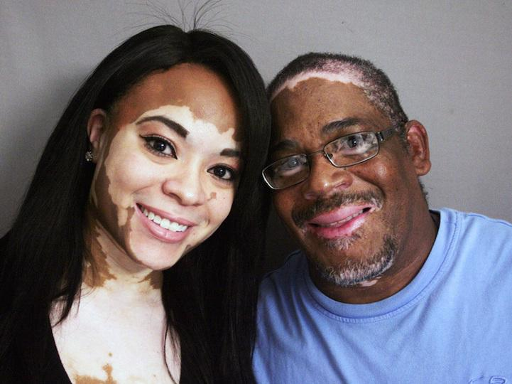
Treatment
There is no way to prevent or cure it
It can be treated which includes
  re-pigmentation using UV light therapy
  cosmetics
  depigmentation of unaffected areas
  corticosteroid cream
  skin grafting

Slide 7
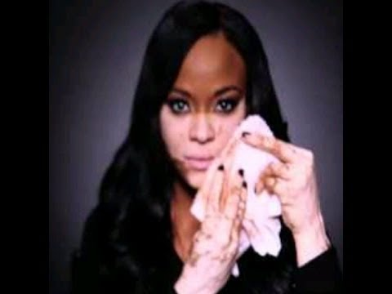
Affect on individuals

Slide 8
Bibliography
http://www.webmd.com/skin-problems-and-treatments/guide/vitiligo-common-cause-loss-skin-pigment
http://www.drscottgraves.com/conditions/chinese-medicine-healing-vitiligo/
http://www.truemichaeljackson.com/health/vitiligo/
https://www.vitiligosupport.org/vitiligo/types.cfm

