Slide 1
Noonan syndrome
Presentation by Katie Gleason

Slide 2
Doctor’s Report
Diagnosis
Observation of symptoms can be difficult as they may be subtle and unnoticeable
Genetic testing can be done
Associated symptoms and Available treatments
Facial features that change through the ages, heart disease, growth issues, musculoskeletal issues, learning disabilities, eye conditions, abnormal bleeding, lymphatic conditions, genital and kidney conditions, and skin conditions
Prognosis
Takes off about ten years of a person's life span

Slide 3
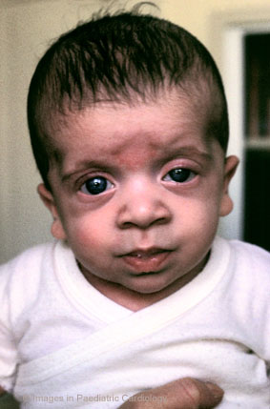
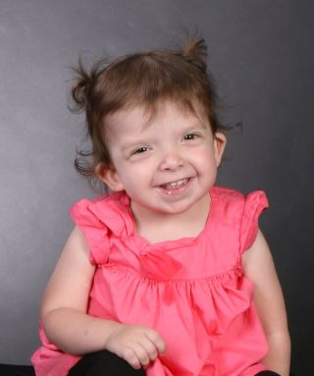
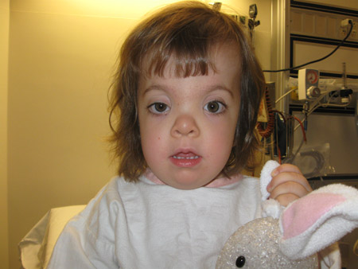
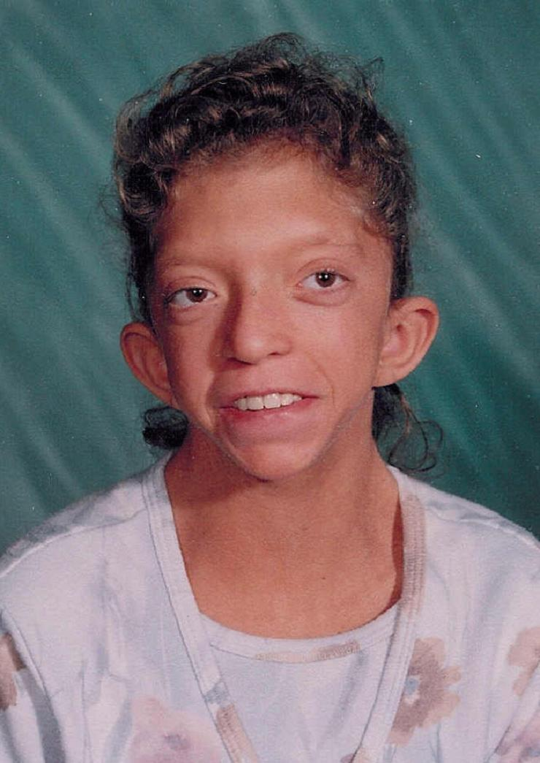
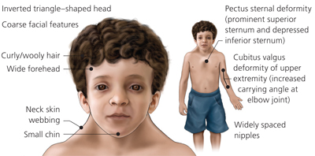
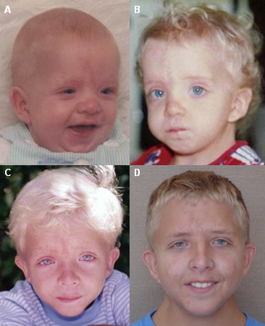
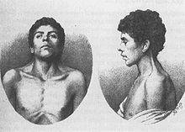
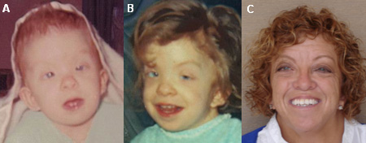

Slide 4
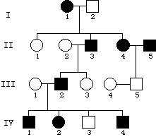
Genetic Counselor's Report
Gene affected and mutation responsible
PTPN11 (50%), SOS1 (10%-15%), RAF1 (5%-10%), KRAS (2%), NRAS and BRAF
Mutation: proteins that are important in signaling pathways needed for the proper formation of tissues
Type of inheritance pattern
Autosomal dominant
Family pedigree
Predicted next generation

Slide 5
Parent’s Report
Financial obligation and limitations
Emotional issues
Ethical considerations
Social concerns

Slide 6
Patient’s Report
Description of symptoms
Progression of disease over past years
Account of living with disease
Concerns of the future

Slide 7
Work Cited
Answer Key -- 371B Autumn 1999, Exam 1. (n.d.). Retrieved November 4, 2015.
BMJ Best Practice. (n.d.). Retrieved November 4, 2015.
Mount Horeb girl suffers from Noonan Syndrome. (n.d.). Retrieved November 4, 2015.
Noonan Syndrome. (n.d.). Retrieved November 4, 2015.
Noonan Syndrome: Read About the Disorder and Its Prognosis. (n.d.). Retrieved November 4, 2015.
Spread Noonan Syndrome Awareness. (n.d.). Retrieved November 4, 2015.

